Slide 1
Types of Privileges

Slide 2
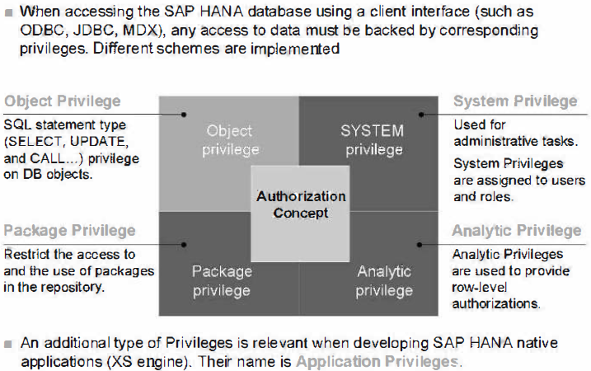
Authorization concept

Slide 3
System Privileges:
Used for administrative tasks.
System Privileges are assigned to users and roles.
Object Privileges:
Used to restrict access to and modification of database objects, such as tables. Depending on the object type (for example, table, view), actions for example, CREATE ANY, ALTER, DROP) can be authorized per object.
Object Privileges are assigned to users and roles.
For Object Privileges in the SAP HANA database, the SQL standard behavior is applied.
Analytic Privileges:
Used to restrict the access for read operations to certain data in Analytic, Attribute, and Calculation Views by filtering the attribute values.
Only applied at the processing time of the user query.
Analytic Privileges need to be defined and activated before they can be granted to users and roles.
Package Privileges:
Used to restrict the access to and the use of packages in the repository of the SAP HANA database.
Packages contain design-time versions of various objects, such as Analytic, Attribute, and Calculation Views, as well as Analytic Privileges, and functions. To be able to work with packages, the respective Package Privileges must be granted.
Application Privileges:
Developers of SAP HANA XS applications can create application privileges to authorize user and client access to their application. They apply in addition to other privileges.
It is recommended to grant application privileges to roles created in the SAP HANA Repository at design time.

Slide 4
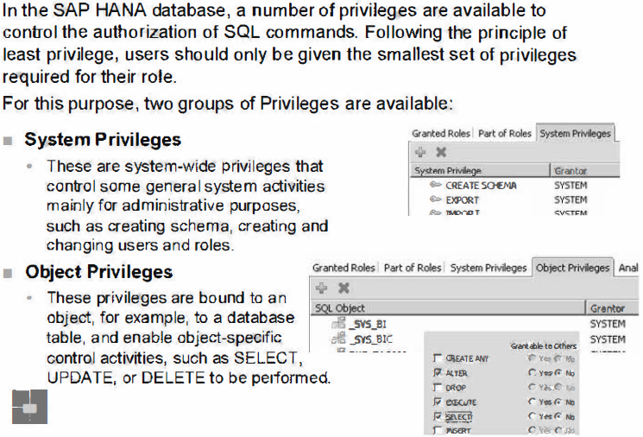
SQL Privilege

Slide 5
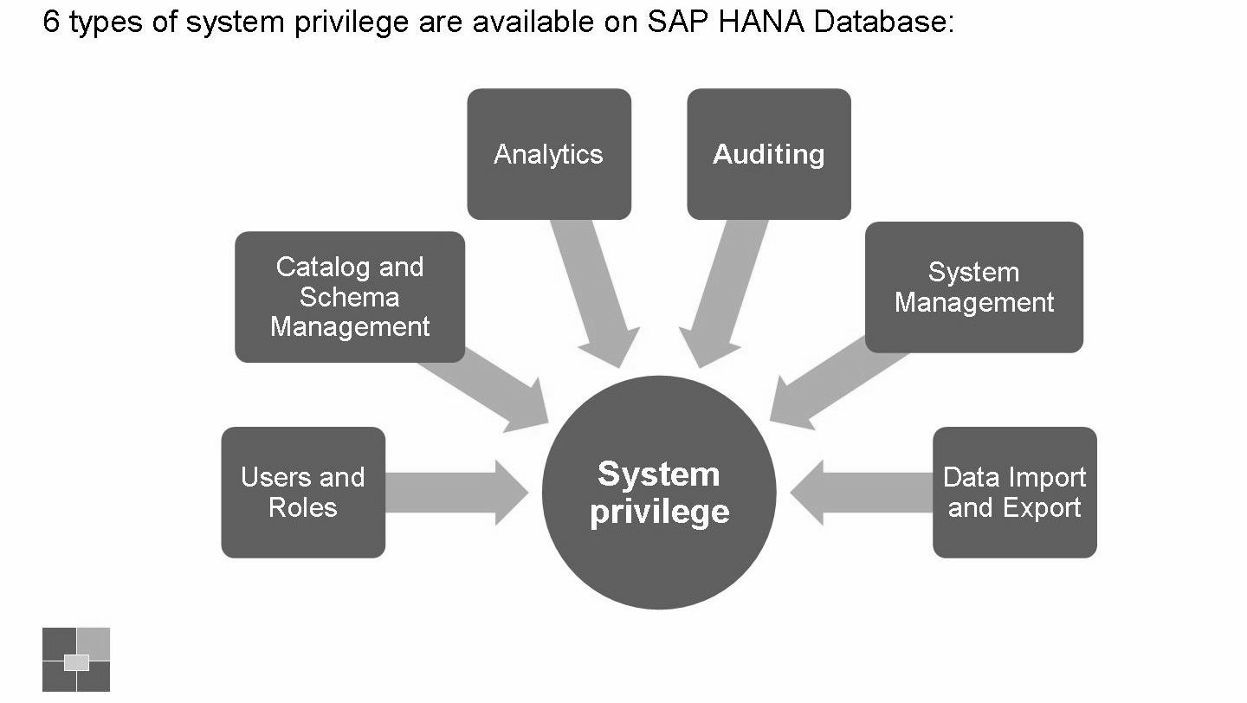
System Privilege

Slide 6
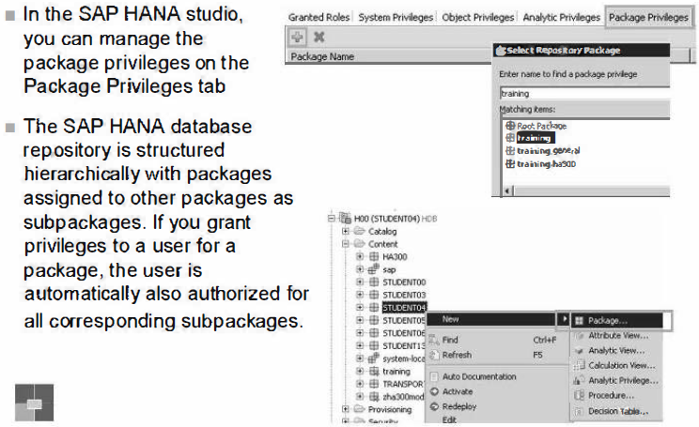
Package Privilege - Assign to users/roles

Slide 7
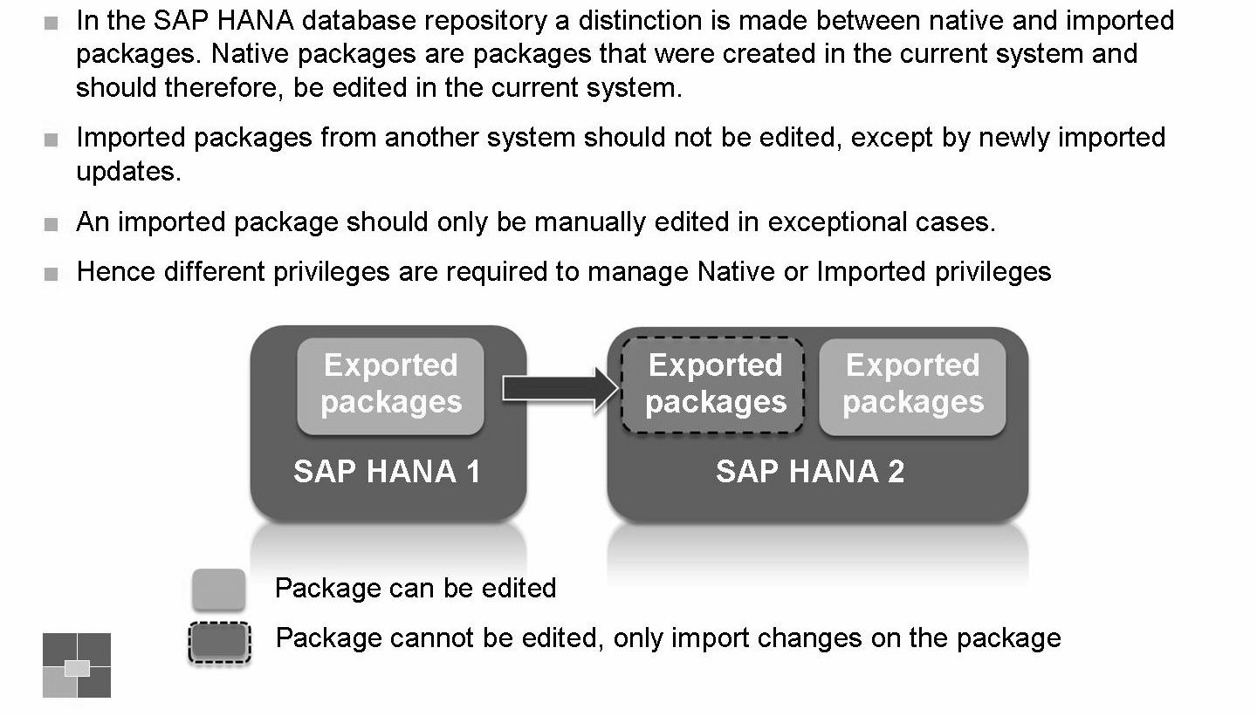
Package Privilege - Native & Imported

Slide 8
Required Permissions
We need a minimum set of permissions to perform the modeling activities such as, create, activate, and data preview on views and analytic privileges.
Object Privileges
_SYS_BI - SELECT privilege
_SYS_BIC - SELECT privilege
REPOSITORY_REST (SYS) - EXECUTE privilege
<schema_where_tables_reside> - SELECT privilege
Analytic Privileges
_SYS_BI_CP_ALL
Package Privileges
Root Package - REPO.MAINTAIN_NATIVE_PACKAGES privilege.
<package_used_for_content_objects> - REPO.READ, REPO.EDIT_NATIVE_OBJECTS & REPO.ACTIVATE_NATIVE_OBJECTS
In the _SYS_REPO user, grant select on schema <schema_where_tables_reside> with Grantable to Others.
For creation of delivery units, you need the REPO.MAINTAIN_DELIVERY_UNITS system privilege
For export & import of delivery units, use the REPO.IMPORT, REPO.EXPORT system privileges
For working in foreign workspaces, use the REPO.WORK_IN_FOREIGN_WORKSPACES system privileges

Slide 9
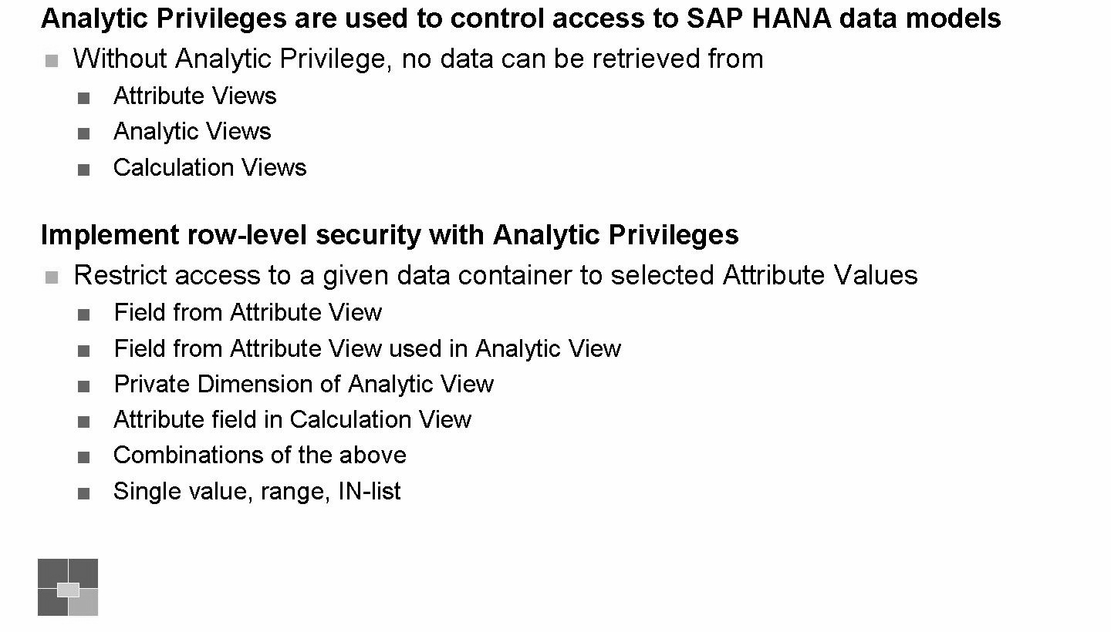
Analytic Privilege - The concept

Slide 10
An Analytic Privilege consists of several restrictions. Three of these restrictions are always present and have the following special meanings:
One restriction (cube restriction) determines for which column views (Attribute, Analytic, or Calculation Views) the privilege is used. This may involve a single view, a list of views or, by means of a wildcard, all applicable views.
One restriction (activity restriction) determines the effected activity, for example, READ. This means that the activity READ is restricted and not available for use.
One restriction (validity restriction) determines at what times the privilege is valid.
In addition to these three restrictions, many additional dimension restrictions are used. These are applied to the actual attributes of a view. Each dimension restriction is relevant for one dimension attribute, which can contain multiple value filters.
Only dimension attributes, and no measures or key figures, can be employed in dimension restrictions.

Slide 11
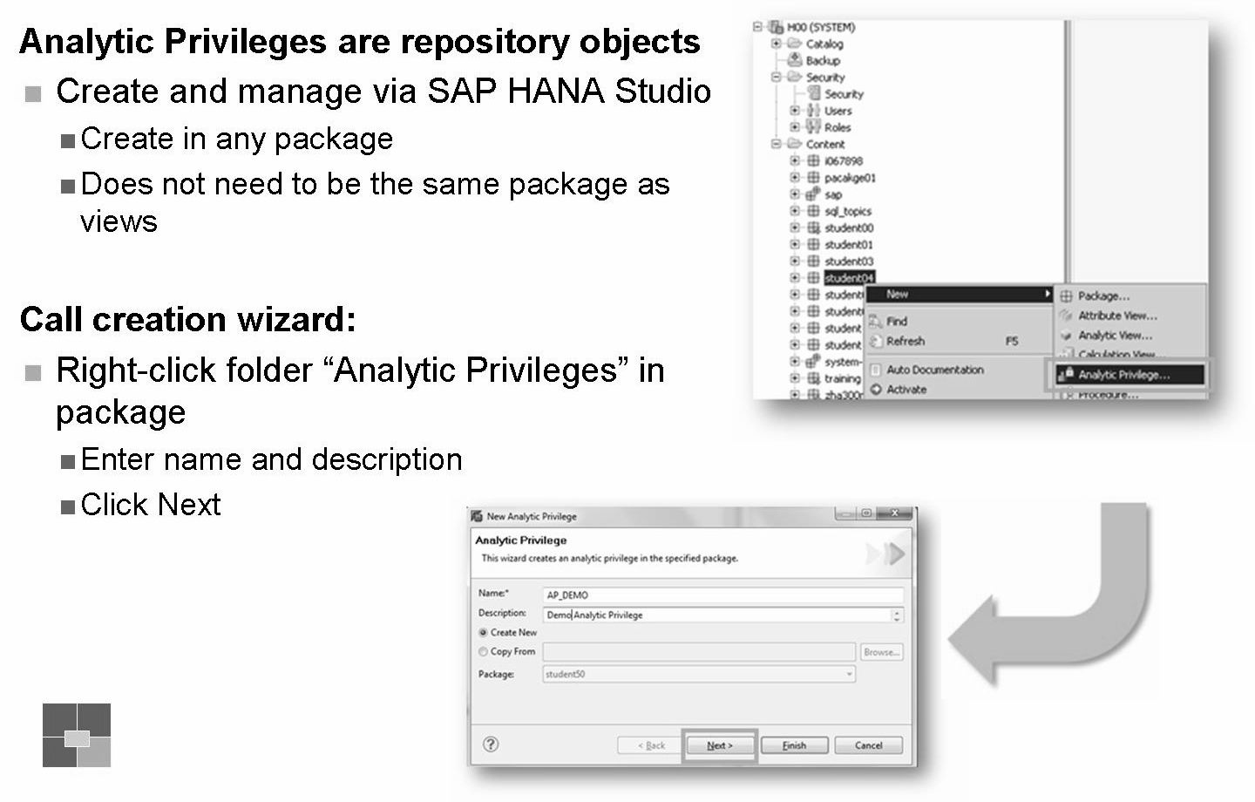
Analytic Privilege - Start creation wizard

Slide 12
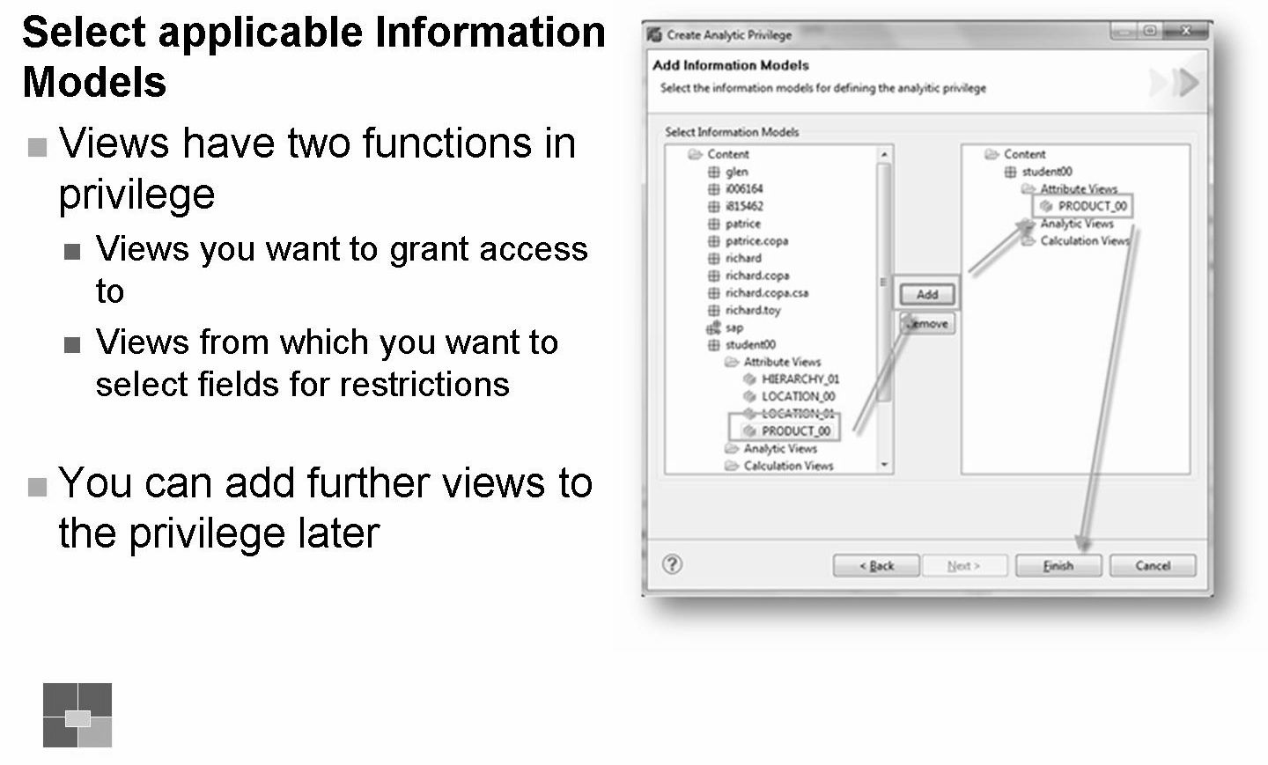
Analytic Privilege - Select Information Models

Slide 13
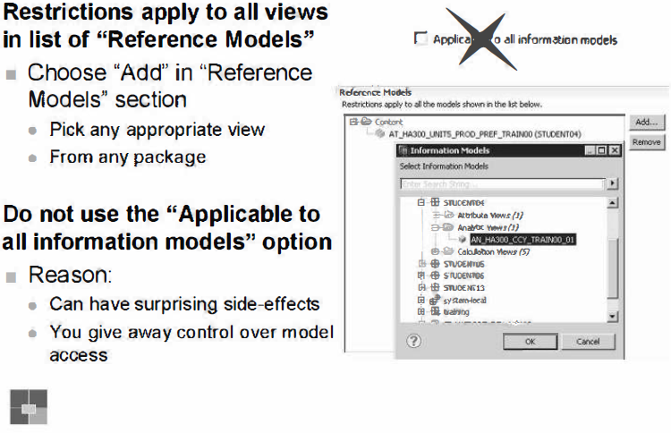

Slide 14
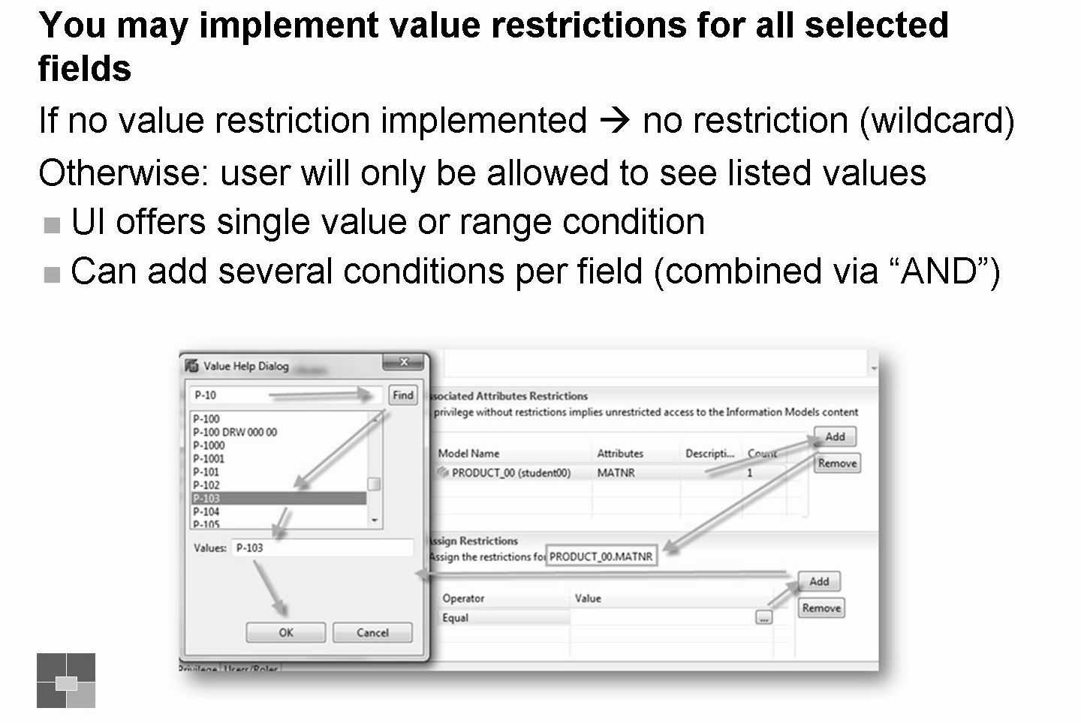
Select field for attribute restriction

Slide 15
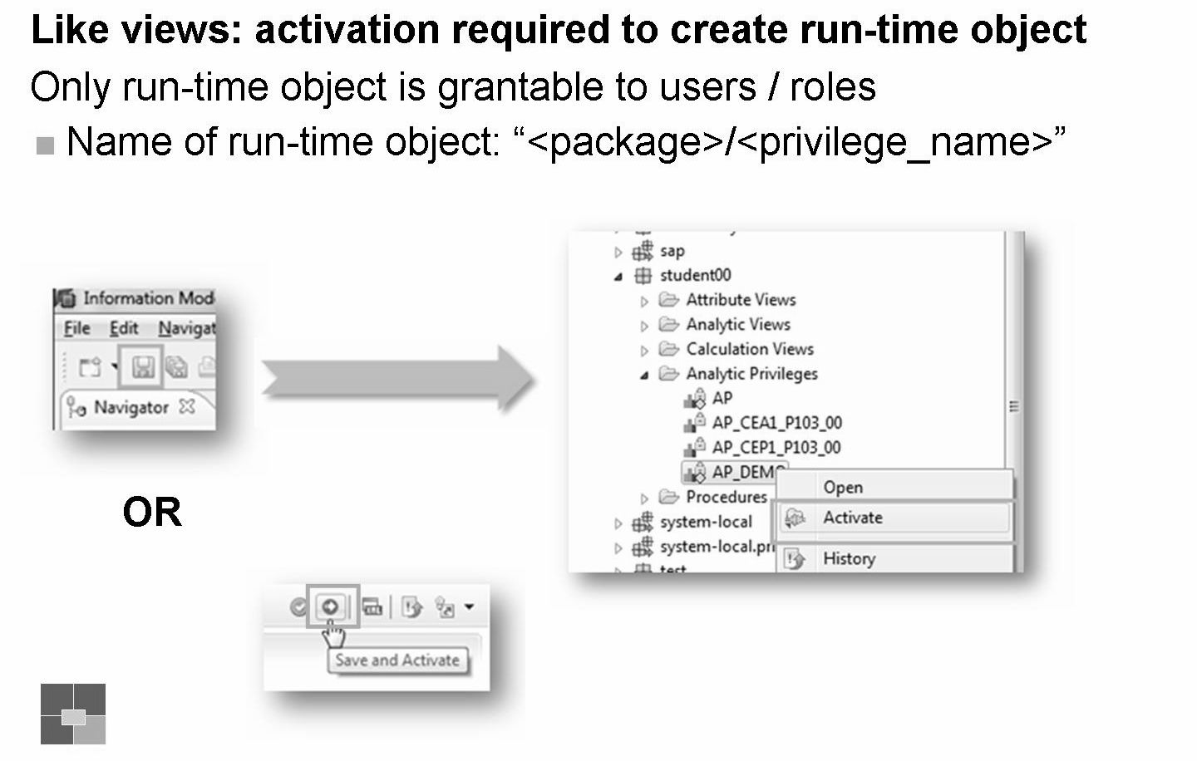

Slide 16
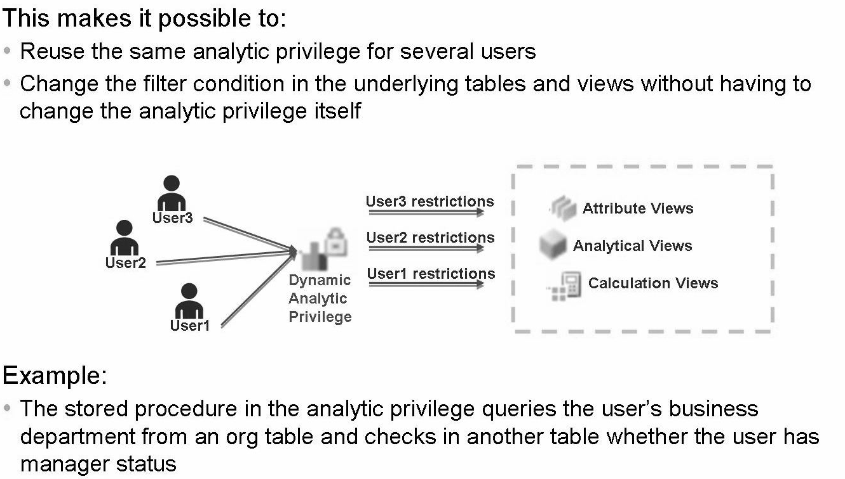
Dynamic Analytic Privilege
In an Analytic Privilege, in addition to static values filtering conditions, it is also possible to determine the filtering conditions via a stored procedure. With this approach the filtering conditions that apply for a specific user are determined at run-time, when querying a specific table or view. This allows a more scalable approach where the same analytic privilege can be applied to multiple users, with different authorization requirements.

Slide 17
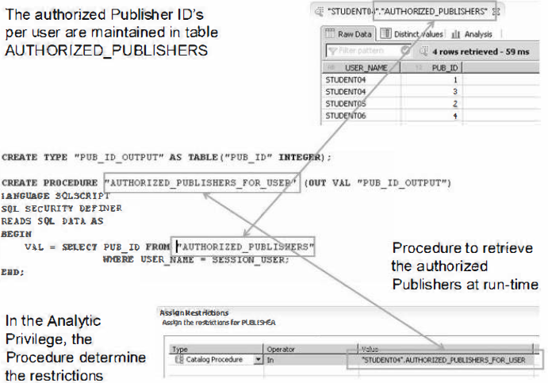
Dynamic Analytic Privilege

Slide 18
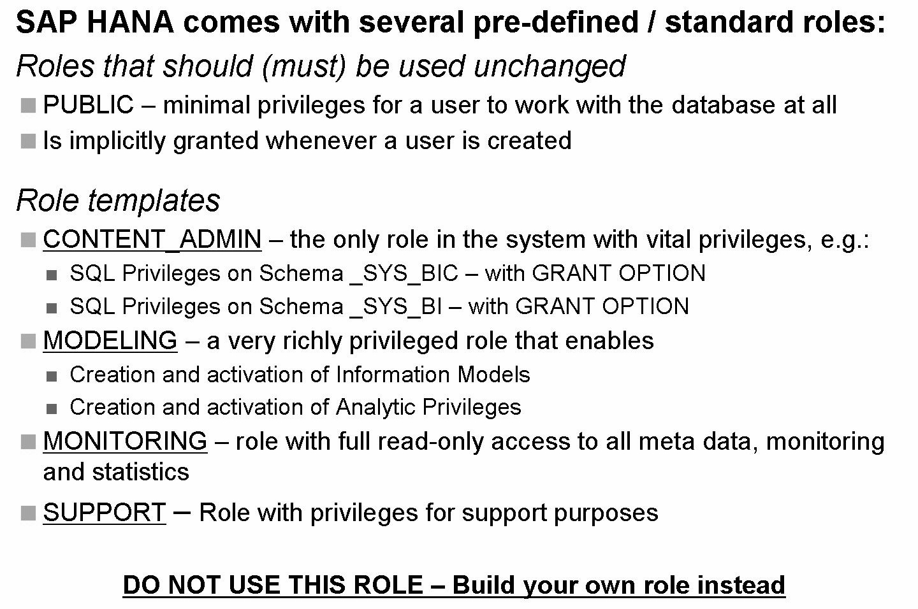

Slide 19
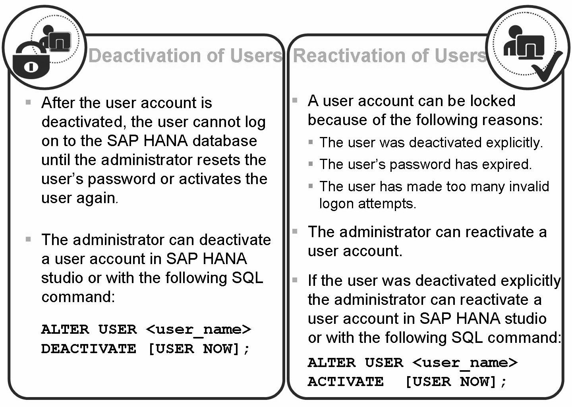
Deactivate / Reactivate a user

Slide 20
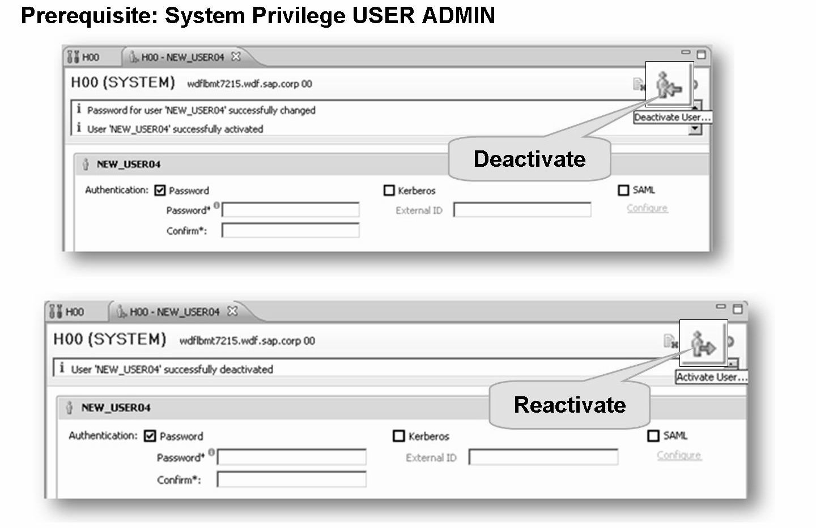
The System Privilege, USER ADMIN, is required to deactivate / reactivate users in the SAP HANA Studio.

Slide 21
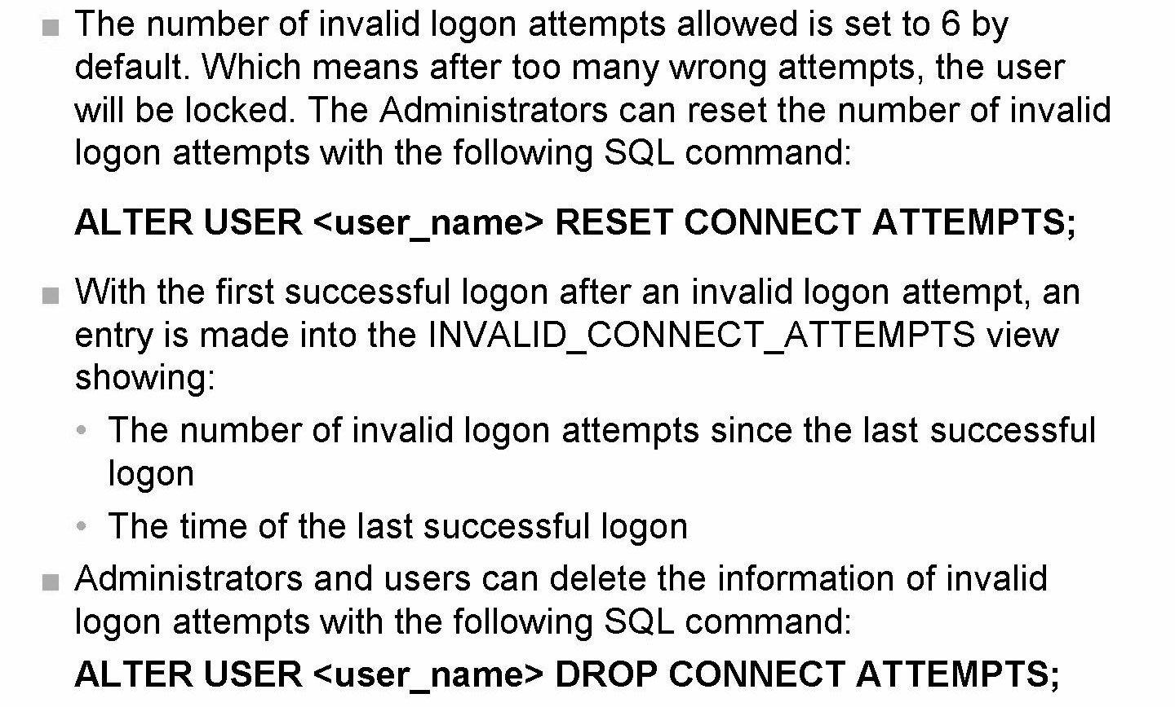
Manage connection attempts

Slide 22
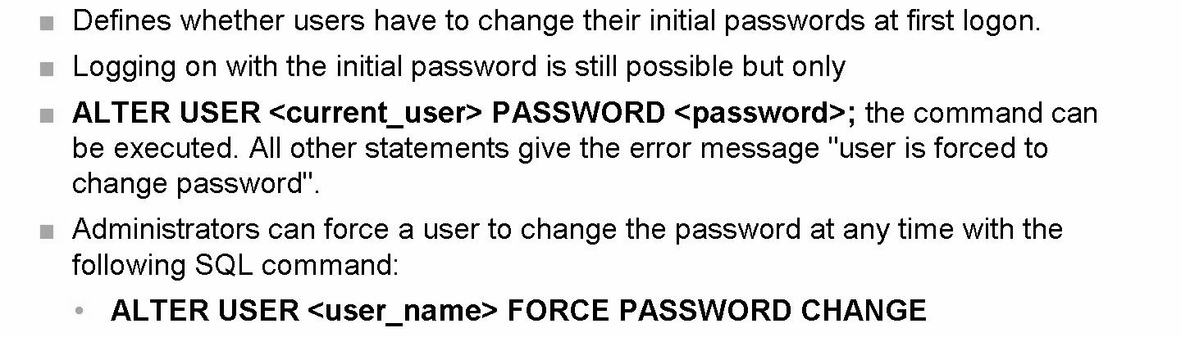
Manage user password

Slide 23
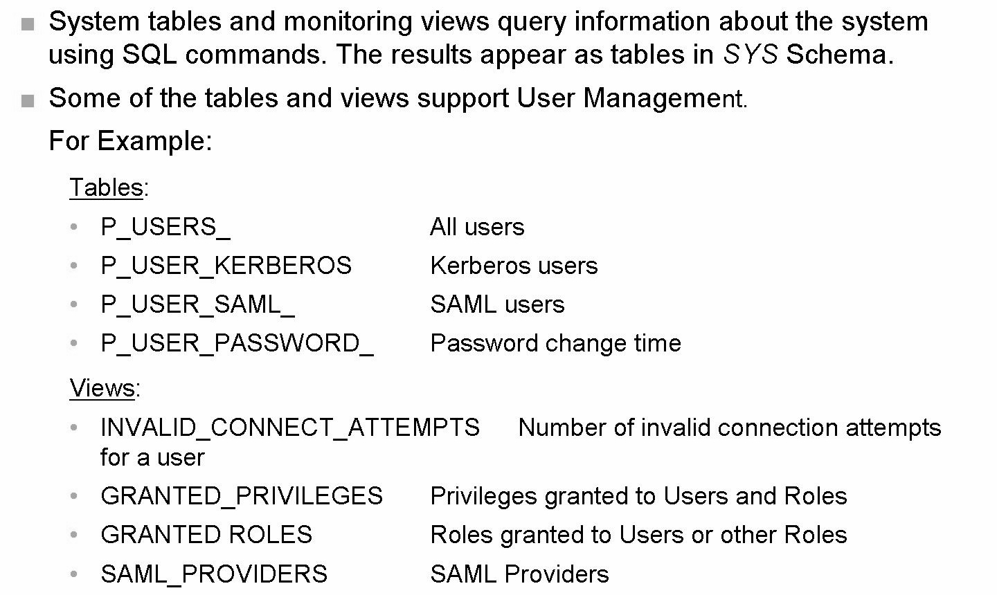
System Tables and Monitoring Views

Slide 24
THANK YOU
Courtesy : SAP Labs Document -
HA 300 – SAP HANA Implementation and Modeling

